Slide 1
CS2S562
Secure Software Development
Pointer Subterfuge*
* deceit (in order to achieve a goal)

Slide 2
Today
Pointer revision
  Why, what they are, how to use
  Value vs. Address
  Pass by value vs. Pass by reference
Pointer vulnerabilities
  Null pointers
  Confusing pointer and value
  Pointer miscalculation
  Forming invalid pointers
  Dangling pointers
  ... and 700+ more pointer problems
  Plus a solution to (most of) these problems

Slide 3
Pointer Revision
Why use Pointers
  easier and faster to pass just the pointer rather than a large amount of data (e.g. large arrays → pass by reference, sorting,...)
  pointers allow clean and compact code
  low-level embedded systems: close to hardware
However….
  pointers are possibly the singlemost biggest source of bugs in C and C++
    dynamic memory management problems and memory leaks (‘malloc’ 3 weaks ago)
    dangling references (pointer points to deleted object)
    with modern compilers not really required any more (?). Often claimed not existing as in Java or C# but in reality still there (array passing / ref keyword in C#).

Slide 4
Pointer Revision
Types of Pointers:
  Pointers are used to point to any type of data (int, char, struct, objects, …)
  i.e. they point to the beginning of such a data block
    Block could be just 1 byte (a char), 2 bytes (a short) or in fact millions of bytes long
  and then there is void*
    void* is a 'generic' pointer that can point to anything
    use sparingly and with great care!
    one of the most frequent sources of bugs, and security problems

Slide 5
Pointer Revision
Address vs. Value
  Memory is a large amount of bits organised into chunks of 8 bits, i.e. bytes
  So in effect memory is a large array of bytes
  Each cell of the array has
    a value
    an address
  The address is called the pointer to the value
Memory
Address | … | 1232 | 1233 | 1234 | 1235 | 1236 | 1237 | 1238 | …
Value (dec) | 15 | 9 | 255 | 0 | 0 | 123 | 13 | 120 | 16

Slide 6
Pointer Revision
And in code:
  int *p;
    Variable p is the address of an integer number somewhere in memory (i.e. dependent on the bits of the int, 1, 2, 4 or more bytes)
  p = &x;
    assign the address of x to p, '&' is the 'address operator'
  z = *p;
    assign the value at address p to z, '*' is the 'dereference operator'
Memory
Address | … | 1232 | 1233 | 1234 | 1235 | 1236 | 1237 | 1238 | …
Value (dec) | 15 | 9 | 255 | 0 | 0 | 123 | 13 | 120 | 16

Slide 7
Pointer Revision
Example:
uint16_t x = 65534; // A standard declaration plus initialisation
Memory
Address | … | 003DCF6C | 003DCF6D | 003DCF6E | 003DCF6F
Value (hex) | ... | FF | FE | 00 | 00
0x FFFE = 65534
1 | 1 | 1 | 1 | 1 | 1 | 1 | 1 | 1 | 1 | 1 | 1 | 1 | 1 | 1 | 0
16 = 0xF |  |  |  | 16 = 0xF |  |  |  | 16 = 0xF |  |  |  | 15 = 0xE

Slide 8
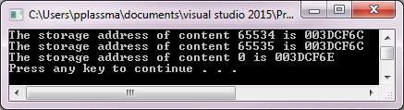
Pointer Revision
Example:
uint16_t x = 65534; // A standard declaration plus initialisation
uint16_t* p; // Declare a pointer p of type uint16_t*
// (i.e. a pointer that will move in steps of 2 bytes)
p = &x; // Make the pointer point to the address of x
cout << "The storage address of content " << *p << " is " << p << endl;
++ *p; // increment the content
cout << "The storage address of content " << *p << " is " << p << endl;
++ p; // increment the pointer - may be anything there
cout << "The storage address of content " << *p << " is " << p << endl;
Memory
Address | … | 003DCF6C | 003DCF6D | 003DCF6E | 003DCF6F
Value (hex) | ... | FF | FE | 00 | 00

Slide 9
Pointer Revision
Creating pointers:
  1. Decide what type you need, e.g.:
    Dynamic array: the array items data type (frequently used)
    Variables: data type of variable (rarely used)
    Struct, Tree or List traversal: use data type of node (occasionally used)
  2. Declare the pointer, e.g.:
    int *i;
    char *someChars
  3. Assign pointer to memory location, e.g.:
    *i = malloc( amount of bytes you want );
    *i = &x; // where x is something like int x=5;
    *i = arr; // where arr could be an int[ ]

Slide 10
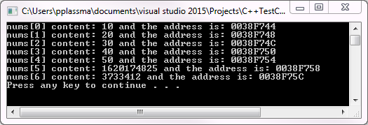
Pointer Revision
Using pointers for accessing data:
uint32_t nums[] = { 10,20,30,40,50 }; // declare and initialise an array of 5 integers
for (int i = 0; i < 7; i++) // deliberate buffer over-run mistake here with y<7
{
cout <<"nums["<<i<<"]content: "<<nums[i]<<" and the address is: "<<&nums[i]<<endl;
}
system("pause");
Address advances in steps of 4 bytes, because of uint32_t
(for uint16_t it would advance by 2, for uint64_t by 8, etc)
Random stack content (due to buffer over-run of ‘for’ loop)

Slide 11
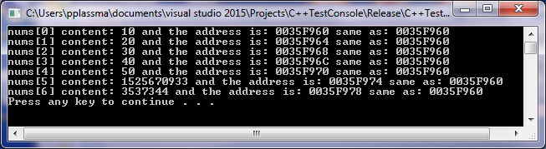
Pointer Revision
Using pointers for accessing data:
uint32_t nums[] = { 10,20,30,40,50 }; // an array of 5 int
uint32_t *p = nums; // p points to nums[0]
for (int i = 0; i < 7; i++) // deliberate buffer over-run mistake here with y<7
{
cout <<"nums["<<i<<"]content: "<<nums[i]<<" and the address is: "<<&nums[i]<<" same as: "<<p<< endl;
}
system("pause");
p does not change. Points always to begin of array

Slide 12
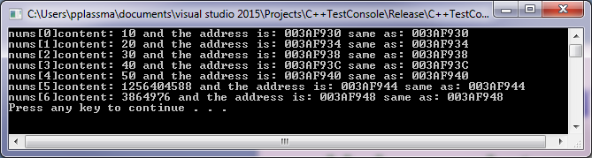
Pointer Revision
Using pointers for accessing data:
uint32_t nums[] = { 10,20,30,40,50 }; // an array of 5 int
uint32_t *p = nums; // p points to nums[0]
for (int i = 0; i < 7; i++, p++) // now increment pointer as well
{
cout <<"nums["<<i<<"]content: "<<nums[i]<<" and the address is: "<<&nums[i]<<" same as: "<<p<< endl;
}
system("pause");
Now p is the same as nums[i]

Slide 13
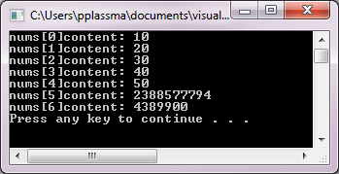
Pointer Revision
Using pointers for accessing data:
uint32_t nums[] = { 10,20,30,40,50 }; // an array of 5 int
uint32_t *p = nums; // p points to nums[0]
for (int i = 0; i < 7; i++, p++) // now increment pointer as well
{
cout <<"nums["<<i<<"]content: "<<*p<< endl;
}
system("pause");
And with *p we can access the content
(but that is REALLY BAD PRACTICE!!!)

Slide 14
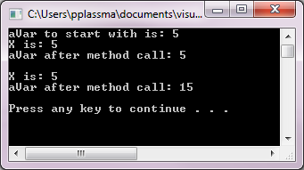
Pointer Revision
Pointers and parameter passing:
  Parameters can be passed by value
  Or by reference (i.e. passing the value of a pointer)
void f1(uint16_t x)
{
cout << "X is: " << x << endl;
++x;
}
void f2(uint16_t &x)
{
cout << "X is: " << x << endl;
x=x+10;
}
int main()
{
uint16_t aVar = 5;
cout << "aVar to start with is: " << aVar << endl;
f1(aVar);
cout << "aVar after method call: " << aVar << endl<<endl;
f2( aVar);
cout << "aVar after method call: " << aVar << endl << endl;
system("pause");

Slide 15
Pointer Revision
Pointers
and structs:
typedef struct
{
int x;
int y;
} Point;
int main()
{
Point p1;
Point p2;
Point *pAddress;
int h=p1.x; // dot notation
p2.y= p1.y
int v = pAddress->x; // arrow notation
int w = (*pAddress).x;
p1=p2; // this is also possible

Slide 16
Pointer Revision
In summary:
  All data is memory
    Each memory location has an address and a value
  A pointer is the data address
    * produces the value pointed to
    & gets the address of a value
    arrays and strings are abstracted variations of pointers
  C is an efficient language but deliberately leaves safety to the programmer
    variables not automatically initialised (as in C#)
    use pointers with great care – common source of problems
    CERT lists 771 error sources (Sept. 1, 2017)

Slide 17
Today
Pointer revision
  Why, what they are, how to use
  Value vs. Address
  Pass by value vs. Pass by reference
Pointer vulnerabilities
  Null pointers
  Confusing pointer and value
  Pointer miscalculation
  Forming invalid pointers
  Dangling pointers
  ... and 700+ more pointer problems
  Plus a solution to (most of) these problems

Slide 18
Pointer Vulnerabilities
Lang | Description | Severity | Likelihood | Remediation Cost | Risk
C | NULL pointer | 3 | 2 | 3 | 18
C | Confusing pointer and value | 3 | 2 | 2 | 12
C | Pointer miscalculation | 3 | 2 | 2 | 12
C | Functions should not form invalid pointers | 1 | 3 | 2 | 6
C | Dangling pointer | 2 | 2 | 2 | 8
C | 700+ more problems here | x | x | x | x
Oddly, CERT does not specifically list pointer vulnerabilities. The table above is entirely home made.
Note: ‘C’ in above table means ‘C and C++’

Slide 19

NULL Pointer
Read File Example:
void readFileCharByChar(char *fileName)
{
FILE *fp;
int c;
fp = fopen(fileName, "r");
do
{
c= fgetc(file);
// do something with
// c here ...
} while (c != EOF);
}
If filename does not exist fopen will return a NULL pointer.
This must be checked by the program: if( fp == NULL ) {....
But: fopen_s should now (‘now’ as in ‘coursework’) be used anyway:
FILE *fp;
int error= fopen_s(&fp, fileName, "r");
if (error)
{
cout << "Could not open file" << endl;
system("pause");
}

Slide 20
NULL Pointer
Another Example:
  Declaring a pointer just allocates space to hold the pointer. It does not create whatever the pointer is pointing to.
  Local variables in C are not initialised (not even to zero), they contain 'rubbish'.
  Can you see the problem?
        void f( )
        {
        int *aPointer;
        *aPointer = 5;
        }
The value pointed to by aPointer is 5 but aPointer points to nowhere!

Slide 21

Pointer Vulnerabilities
Lang | Description | Severity | Likelihood | Remediation Cost | Risk
C | NULL pointer | 3 | 2 | 3 | 18
C | Confusing pointer and value | 3 | 2 | 2 | 12
C | Pointer miscalculation | 3 | 2 | 2 | 12
C | Functions should not form invalid pointers | 1 | 3 | 2 | 6
C | Dangling pointer | 2 | 2 | 2 | 8
C | 700+ more problems here | x | x | x | x
Oddly, CERT does not specifically list pointer vulnerabilities. The table above is entirely home made.
Note: ‘C’ in above table means ‘C and C++’

Slide 22
Example: Passing Arrays
How?
void printArray( )
{
for (int i = 0; i < 6; ++i)
{
cout << "Element " << i << " is: " << arr[i] << endl;
}
}
int main()
{
int x[6] = { 100, 200, 300, 400, 500, 600 };
printArray( );
system("Pause"); // creates 'Any key to continue'
return 0;
}
What goes here:
*x, x or &x ?
*x: * is the dereference operator, so *x refers to the content of the first element.
So: cout<<"*x is: "<<*x<< endl; results in: *x is: 100
x: In an array the name already IS a pointer to its first element.
So: cout<<"x is: "<<x<< endl; results in something like: x is: 14FB9C1B
&x: & is the reference operator, so &x is a pointer to the pointer to the first element. So: cout<<"&x is: "<<&x<< endl; results in the same as x: &x is: 14FB9C1B

Slide 23
Example: Passing Arrays
How?
int *arr
void printArray( )
{
for (int i = 0; i < 6; ++i)
{
cout << "Element " << i << " is: " << arr[i] << endl;
}
}
int main()
{
int x[6] = { 100, 200, 300, 400, 500, 600 };
printArray( x );
system("Pause"); // creates 'Any key to continue'
return 0;
}
And here:
int arr, int &arr or int *arr ?
arr: x in printArray(x) is a pointer to the array but arr is just an int.
➔Type conflict, results in compiler error
&arr: & is the reference operator so &arr would be a ref. to the reference passed in
➔ Type conflict, results in compiler error
*arr: that is also a pointer.
➔ Type match. Correct.

Slide 24
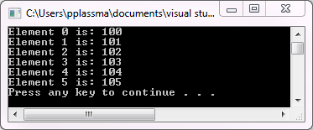
Example: Passing Arrays
This also compiles but what is the output?
void printArray( int arr )
{
for (int i = 0; i < 6; ++i)
{
cout << "Element " << i << " is: " << arr << endl;
++arr;
}
}
int main()
{
int x[6] = { 100, 200, 300, 400, 500, 600 };
printArray( *x );
system("Pause"); // creates 'Any key to continue'
return 0;
}
arr: is just a plain integer, so it can hold the 100 being passed in.
*x: x points to first element in the array. * is the dereference operator, so *x refers to the content of the first element, i.e. *x is the number 100

Slide 25
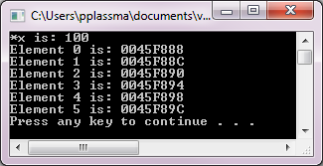
Example: Passing Arrays
And what about this?
void printArray( int *arr )
{
for (int i = 0; i < 6; ++i)
{
cout << "Element " << i << " is: " << arr << endl;
++arr;
}
}
int main()
{
int x[6] = { 100, 200, 300, 400, 500, 600 };
printArray( x );
system("Pause"); // creates 'Any key to continue'
return 0;
}
*arr: is a pointer (i.e. an address) so it can hold the address of the first element in the array passed in
x: x points to first element in the array. It is an address
Address counts up in steps of 4 bytes. So ‘int’ must be 4*8 = int32_t here.

Slide 26
Pointer Vulnerabilities
Lang | Description | Severity | Likelihood | Remediation Cost | Risk
C | NULL pointer | 3 | 2 | 3 | 18
C | Confusing pointer and value | 3 | 2 | 2 | 12
C | Pointer miscalculation | 3 | 2 | 2 | 12
C | Functions should not form invalid pointers | 1 | 3 | 2 | 6
C | Dangling pointer | 2 | 2 | 2 | 8
C | 700+ more problems here | x | x | x | x
Oddly, CERT does not specifically list pointer vulnerabilities. The table above is entirely home made.
Note: ‘C’ in above table means ‘C and C++’

Slide 27
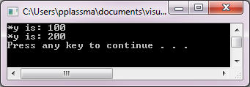

Pointer Miscalculation
What is the output?
int main()
{
int x[6] = { 100, 200, 300, 400, 500, 600 };
int *y = x;
cout << "*y is: " << *y << endl;
++y;
cout << "*y is: " << *y << endl;
y = y + 10;
cout << "*y is: " << *y << endl;
system("Pause"); // creates 'Any key to continue'
return 0;
}

Slide 28
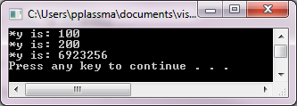
Pointer Miscalculation
What is the output?
int main()
{
int x[6] = { 100, 200, 300, 400, 500, 600 };
int *y = x;
cout << "*y is: " << *y << endl;
++y;
cout << "*y is: " << *y << endl;
y = y + 10;
cout << "*y is: " << *y << endl;
system("Pause"); // creates 'Any key to continue'
return 0;
}

Slide 29
Pointer Vulnerabilities
Lang | Description | Severity | Likelihood | Remediation Cost | Risk
C | NULL pointer | 3 | 2 | 3 | 18
C | Confusing pointer and value | 3 | 2 | 2 | 12
C | Pointer miscalculation | 3 | 2 | 2 | 12
C | Functions should not form invalid pointers | 1 | 3 | 2 | 6
C | Dangling pointer | 2 | 2 | 2 | 8
C | 700+ more problems here | x | x | x | x
Oddly, CERT does not specifically list pointer vulnerabilities. The table above is entirely home made.
Note: ‘C’ in above table means ‘C and C++’

Slide 30
Invalid Pointer Calculation
What is the problem?
void aFunction() {
char arr[40];
const char *txt = “Some text";
uint16_t n = sizeof(arr);
memcpy(arr, txt, n);
}
memcpy copies n bytes from txt to arr
i.e. the programmer wants to copy the text in txt into arr
However, the value of n is set incorrectly to 40
(sizeof() calculates the amount of bytes in an array, char is 1 byte in size)
Result: over-run of txt buffer inside memcpy

Slide 31
Pointer Vulnerabilities
Lang | Description | Severity | Likelihood | Remediation Cost | Risk
C | NULL pointer | 3 | 2 | 3 | 18
C | Confusing pointer and value | 3 | 2 | 2 | 12
C | Pointer miscalculation | 3 | 2 | 2 | 12
C | Functions should not form invalid pointers | 1 | 3 | 2 | 6
C | Dangling pointer | 2 | 2 | 2 | 8
C | 700+ more problems here | x | x | x | x
Oddly, CERT does not specifically list pointer vulnerabilities. The table above is entirely home made.
Note: ‘C’ in above table means ‘C and C++’

Slide 32
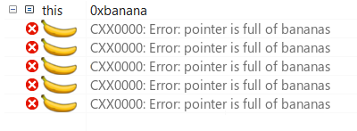
Dangling Pointers
What is it?
  If the object pointing to gets deleted (deallocated) the pointer continues to point to this memory (the pointer itself was not deleted).
  Deallocated memory can be allocated again and the pointer may then be used to access this new content.
  This leads to unpredictable results at best, usually to stack corruption (segmentation / general protection fault) and is an attack vector at worst.
{
char *dp = NULL;
{
char c;
dp = &c;
}
// c out of scope here
// dp is now a dangling pointer
}
Scope of db
Scope of c

Slide 33
Pointer Vulnerabilities
Lang | Description | Severity | Likelihood | Remediation Cost | Risk
C | NULL pointer | 3 | 2 | 3 | 18
C | Confusing pointer and value | 3 | 2 | 2 | 12
C | Pointer miscalculation | 3 | 2 | 2 | 12
C | Functions should not form invalid pointers | 1 | 3 | 2 | 6
C | Dangling pointer | 2 | 2 | 2 | 8
C | 700+ more problems here | x | x | x | x
Oddly, CERT does not specifically list pointer vulnerabilities. The table above is entirely home made.
For another day.....
Note: ‘C’ in above table means ‘C and C++’

Slide 34


Summary
Pointer are very useful
  easier and faster to pass just the pointer rather
  than a large amount of data (pass by reference)
  pointers allow clean and compact code
  low-level embedded systems: close to hardware
But they are also very dangerous
“C makes it easy to shoot yourself in the foot; C++ makes it harder, but when you do, it blows away your whole leg.”
Bjarne Stroustrup, inventor of C++

Slide 35
Therefore....
Smart Pointers
  Classes that wrap-up pointers AND the pointed-to object
  Introduced pre C11: auto_ptr and shared_ptr
  But these created performance problems (slow)
  New in C11: unique_ptr (in lab)

Slide 36
End of Lecture

